Slide 1

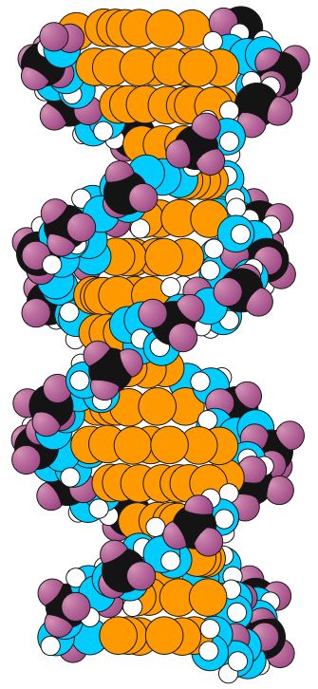

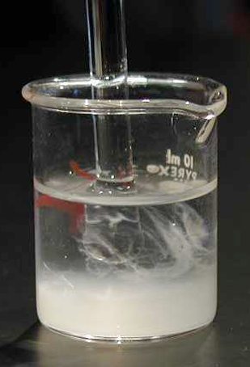

Genes & Inheritance Series: Set 1
Copyright © 2005
Version: 2.0

Slide 2
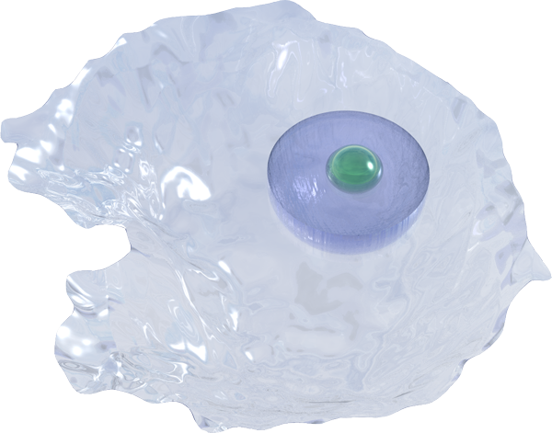
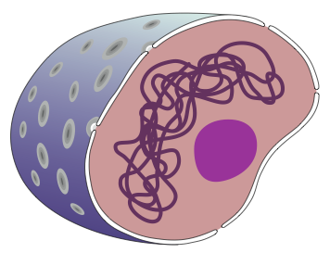
Genes in Eukaryote Cells
Eukaryotes have genetic information stored in chromosomes in the nucleus of each cell:
Nucleus contains inherited information: The total collection of genes located on chromosomes in the nucleus has the complete instructions for constructing a total organism.
Cytoplasm: The nucleus controls cell metabolism; the many chemical reactions that keep the cell alive and performing its designated role.
Nucleus
Structure of the nucleus
Nuclear pores are involved in the active transport of substances into and out of the nucleus
Nuclear membrane
encloses the nucleus in eukaryotic cells
Chromosomes are made up of DNA and protein and store the information for controlling the cell
Nucleolus is involved in the construction of ribosomes

Slide 3
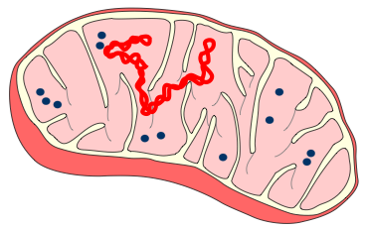
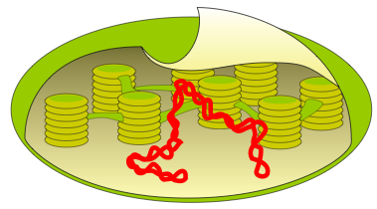

Genes Outside the Nucleus in Eukaryote Cells
Eukaryotes have two types of organelles with their own DNA:
  mitochondria
  chloroplasts
The DNA of these organelles is replicated when the organelles are reproduced (independently of the DNA in the nucleus).
Mitochondrial
DNA
Mitochondrion
Ribosome
Chloroplast
Chloroplast DNA

Slide 4
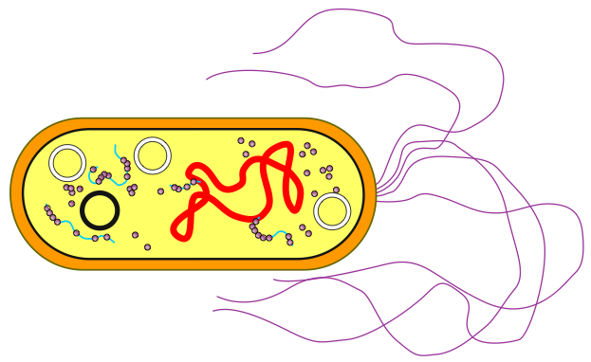

Genes in Prokaryote Cells
Flagellum
Bacteria have no membrane-bound organelles.
Cellular reactions occur on the inner surface of the cell membrane or in the cytoplasm.
Bacterial DNA is found in:
  One, large circular chromosome.
  Several small chromosomal structures called plasmids.
Cytoplasm
(no nucleus)
Single, circular
chromosome
Ribosomes
Cell membrane
Cell wall
Plasmids

Slide 5
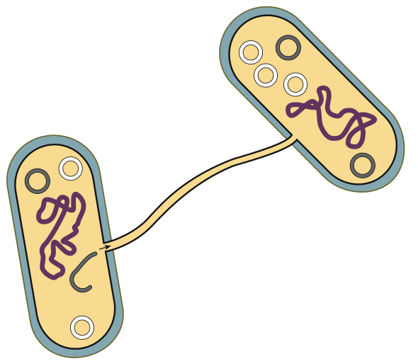
Plasmid DNA
Bacteria have small accessory chromosomes called plasmids.
Plasmids replicate independently of the main chromosome.
Some conjugative
plasmids can be
exchanged with other
bacteria in a process
called conjugation.
Via conjugation, plasmids
can transfer antibiotic
resistance to other bacteria.
Recipient
bacterium
Sex pilus conducts the plasmid to the recipient bacterium
Plasmid of the conjugative type
A plasmid about to pass one strand of the DNA into the sex pilus
Plasmid of the
non-conjugative type
Donor
bacterium

Slide 6
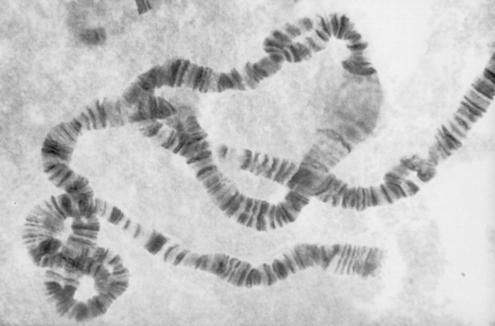
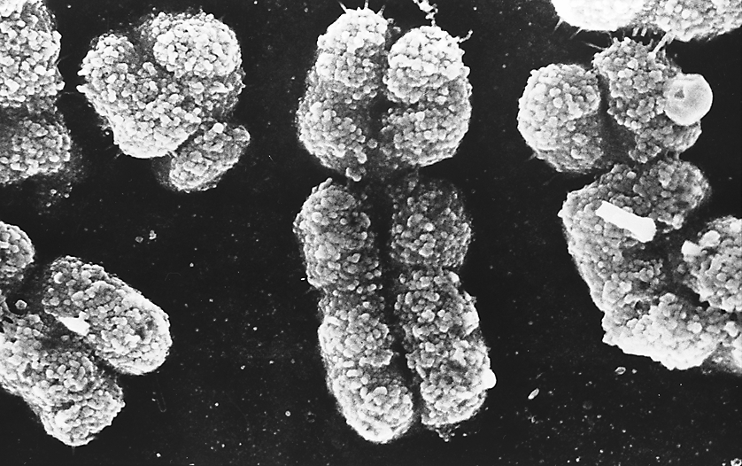
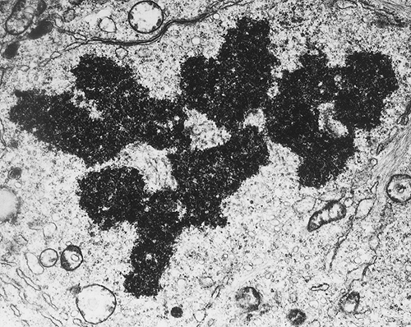


Chromosomes
Chromosomes can be represented in different forms by using a variety of microscopes:
  A: Light microscope view of a chromosome
  from the salivary glands of the fly Simulium.
    Banding: groups of genes stained light and dark.
    Puffing: areas of transcription (mRNA production).
  B: Scanning electron microscope (SEM) view of sex chromosomes in the condensed state during a
  cell division. Individual chromatin fibers are visible.
    The smaller chromosome is the ‘Y’ while the
    larger one is the X.
  C: Transmission electron microscope (TEM) view of chromosomes lined up at the equator of a cell during the process of cell division. These chromosomes are also in the condensed state.
A
B
C

Slide 7
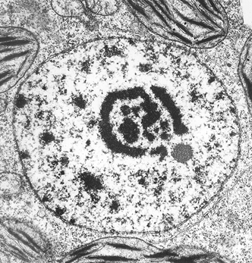



Chromosome States
Interphase: Chromosomes are single-armed structures during their unwound state during interphase.
Dividing cells: Chromosomes are double-armed structures, having replicated their DNA to form two chromatids in preparation for cell division.
Interphase
chromosome
Replicated chromosome
prepared for cell division
Chromatin
Centromere
This chromosome would not be visible as a coiled up structure, but unwound as a region of dense chromatin in the nucleus (as in the TEM of the nucleus above)
Chromatid
Chromatid

Slide 8
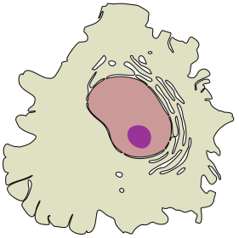

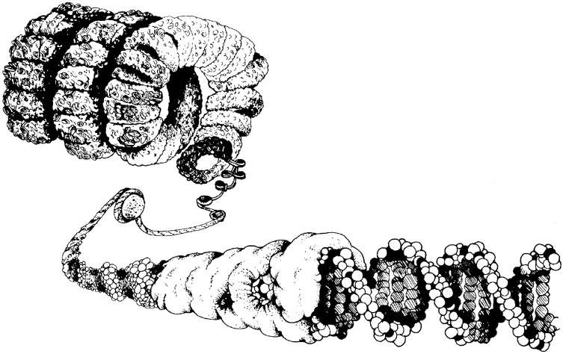
Chromosome Structure
Histone proteins organize the DNA into tightly coiled structures (visible chromosomes) during cell division.
Coiling into compact structures allows the chromatids to separate without tangling during cell division.
Replicated chromosome
Chromatin: a complex of DNA and protein
Cell
Individual atoms
Histone proteins
DNA molecule
(double helix comprising genes)

Slide 9
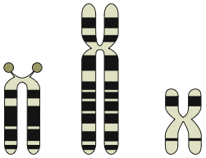
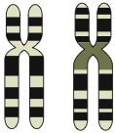
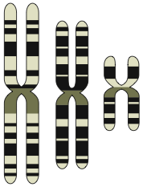
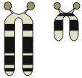
Chromosome Features
Chromosomes can be identified by noting:
  Banding patterns
  Position of the centromere
  Presence of satellites
  Length of the chromatids
These features enable homologous pairs to be matched and therefore accurate karyotypes to be made.
Banding pattern
Acrocentric
Submetacentric or Subterminal
Metacentric
Centromere position
Satellite endings
Chromosome length

Slide 10
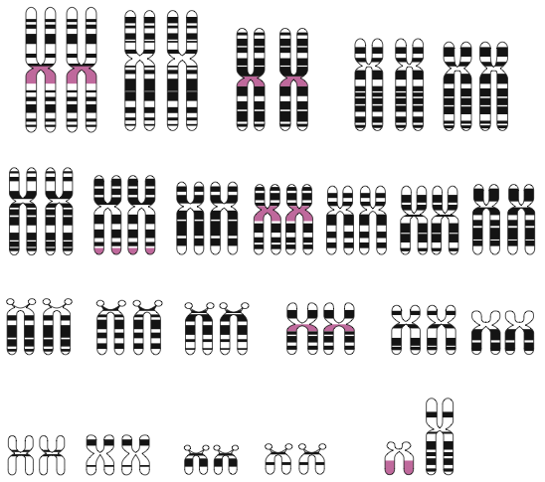
Human Karyotypes
Karyotypes display the chromosome contents of a cell, organized according to their number, size and type.
Normal somatic human cells have a karyotype with 46 chromosomes (in 23 pairs) comprising:
  22 pairs of autosomes.
  1 pair of sex chromosomes.
  These determine the sex of an individual:
    XX = female
    XY = male
1
2
3
4
5
6
7
8
9
10
11
12
13
14
15
16
17
18
19
20
21
22
Y
X
Sex chromosomes

Slide 11

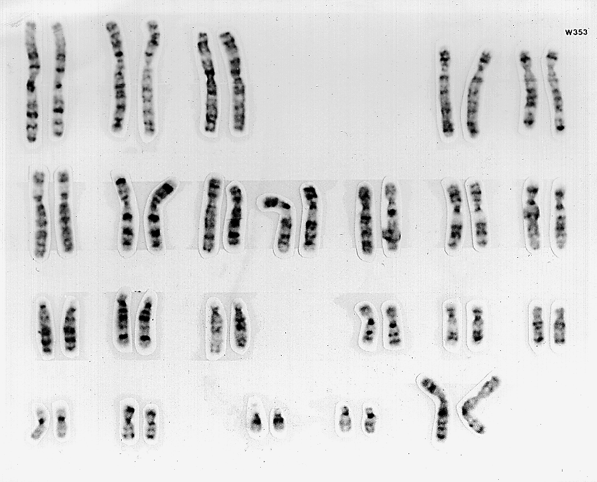
Human Female Karyotype
Every cell (except egg cells) in a normal human female has:
  44 autosomes
  2 sex chromosomes
Human Female: 44 + XX
Sex chromosomes: XX = female

Slide 12

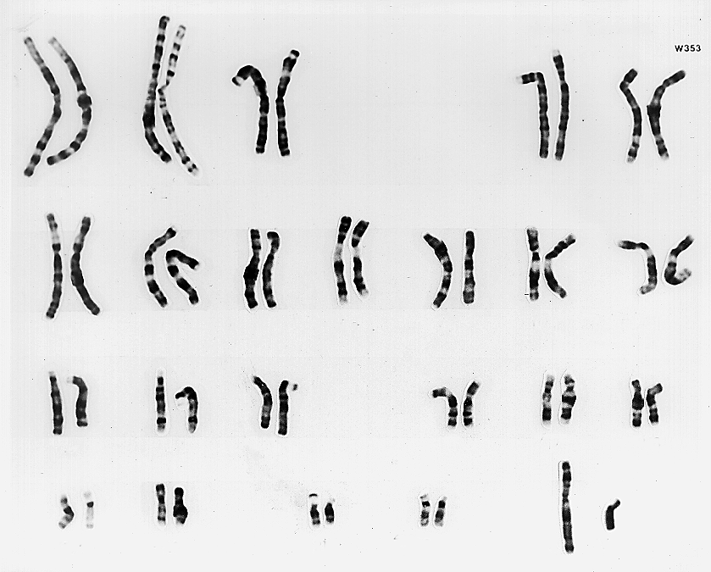
Human Male Karyotype
Every cell (except sperm cells) in a normal human male has:
  44 autosomes
  2 sex chromosomes
Human Male: 44 + XY
Sex chromosomes: XY = male

Slide 13





Chromosomes Contain Genes
A single chromosome may contain hundreds of genes.
  Below are the locations of some known genes on human chromosomes:
El
Rh
AMY
Fy
RB
MN
TYS
CBD
ABO
HEMA
NP
Chromosome:
No. of genes:
1
4
9
13
X
1270
465
499
195
773

Slide 14
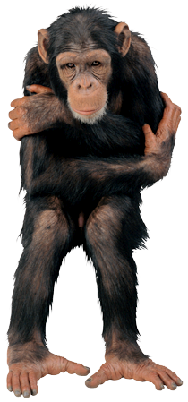

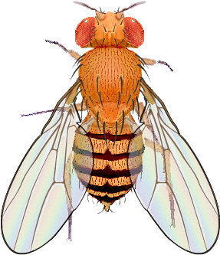
Numbers of Chromosomes
Chromosome numbers vary considerably among organisms.
The numbers may differ markedly even between closely related species:
Organisms | Chromosome No.
human | 46
chimpanzee | 48
gorilla | 48
cattle | 60
cat | 38
goldfish | 94
Drosophila | 8
honey bee | 32 or 16
Hydra | 32
cabbage | 18
beans | 22
orange | 18, 27 or 36
garden pea | 14

Slide 15
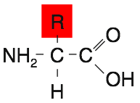
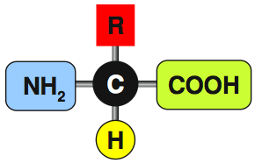
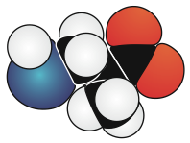
Amino Acids
Amino acids are linked together to form proteins.
All amino acids have the same general structure, but each type differs from the others by having a unique ‘R’ group.
  The ‘R’ group is the variable part of the amino acid.
20 different amino acids are commonly found in proteins.
The 'R' group varies in chemical make-up with each type of amino acid
Example of an amino acid shown as a space filling model: Cysteine
Carbon atom
Amine group
Symbolic formula
Hydrogen atom
Carboxyl group makes the molecule behave like a weak acid

Slide 16
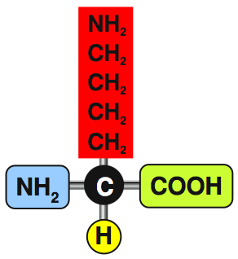
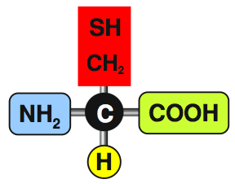
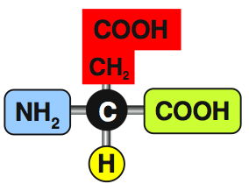
Types of Amino Acid
Amino acids with different types of ‘R’ groups have different chemical properties:
Forms di-sulfide bridges that can link to similar amino acids
Basic
Acidic
Cysteine
(forms di-sulfide bridges)
Lysine
(basic)
Aspartic acid
(acidic)

Slide 17
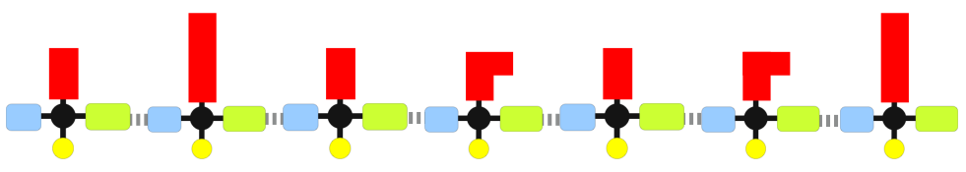
Polypeptide Chains
Amino acids are liked together in long chains by the formation of peptide bonds.
Long chains of such amino acids are called polypeptide chains.
Polypeptide chain
Peptide
bond
Peptide
bond
Peptide
bond
Peptide
bond
Peptide
bond
Peptide
bond

Slide 18
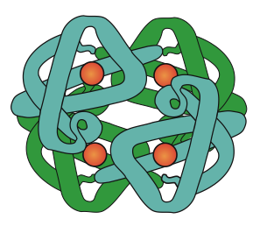
Protein Function
Proteins can be classified according to their functional role in an organism:
Hemoglobin
Function |  | Examples
Structural | Forming the structural components of organs | Collagen, keratin
Regulatory | Regulating cellular function (hormones) | Insulin, glucagon, adrenalin, human growth hormone, follicle stimulating hormone
Contractile | Forming the contractile elements in muscles | Myosin, actin
Immunological | Functioning to combat invading microbes | antibodies such as Gammaglobulin
Transport | Acting as carrier molecules | Hemoglobin, myoglobin
Catalytic | Catalyzing metabolic reactions (enzymes) | amylase, lipase, lactase, trypsin

Slide 19
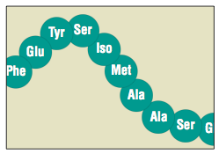

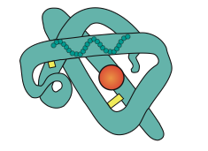
Protein Structure
Amino acid
The production of a functional protein requires that the polypeptide chain assumes a precise structure comprising several levels:
  Primary structure: The sequence of amino acids in a polypeptide chain.
  Secondary structure: The shape of the polypeptide chain (e.g. alpha-helix).
  Tertiary structure: The overall conformation (shape) of the polypeptide caused by folding.
  Quaternary structure: In some proteins, an additional level of organization groups separate polypeptide chains together to form
  a functional protein.
Di-sulfide bridge
Alpha chain
Beta chain
Beta chain
Alpha chain
Hemoglobin molecule

Slide 20
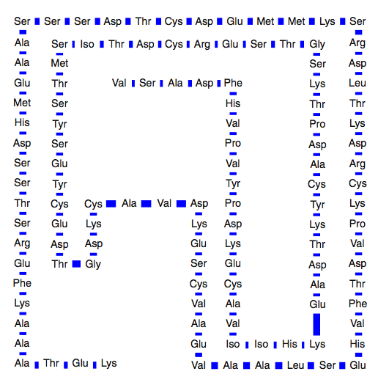



Beef Ribonuclease
Bridge
Enzyme for catalyzing the breakdown of RNA in cattle.
The tertiary structure of the protein is maintained by four
di-sulfide bridges between the cysteine bases.
The enzyme comprises a total of 123 amino acids.
Bridge
Bridge
Bridge

Slide 21
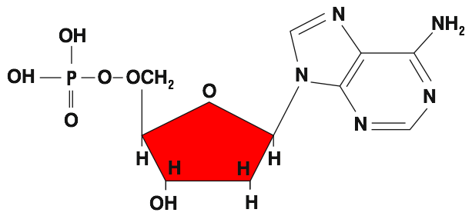
Nucleotides
The building blocks of nucleic acids (DNA and RNA) comprise the following components:
  a sugar (ribose or deoxyribose)
  a phosphate group
  a base (four types for each of DNA and RNA)
Adenine
Phosphate
Sugar
Base

Slide 22
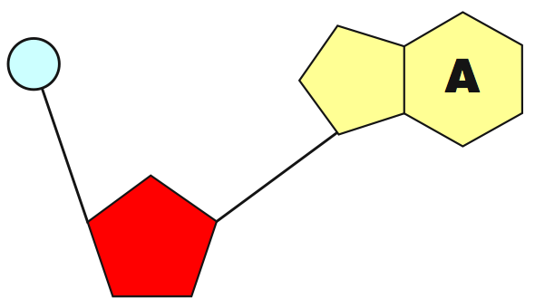
Structure of Nucleotides
The chemical structure of nucleotides:
Symbolic form
Phosphate: Links neighboring sugars
Base: Four types are possible in DNA: adenine, guanine, cytosine and thymine. RNA has the same except uracil replaces thymine.
Sugar: One of two types possible: ribose in RNA and deoxyribose in DNA

Slide 23
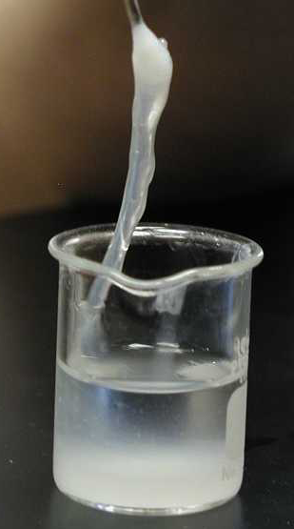
Nucleic Acids
What does DNA look like?
It’s not difficult to isolate DNA from cells.
The DNA extracted from a lot of cells can be made to form a whitish, glue-like material.
DNA

Slide 24
Types of Nucleic Acid
Nucleic acids are found in two forms: DNA and RNA
DNA is found in the following places:
  Chromosomes in the nucleus of eukaryotes
  Chromosomes and plastids of prokaryotes
  Mitochondria
  Chloroplasts of plant cells
RNA is found in the following forms:
  Transfer RNA: tRNA
  Messenger RNA: mRNA
  Ribosomal RNA: rRNA
  Genetic material of some viruses

Slide 25
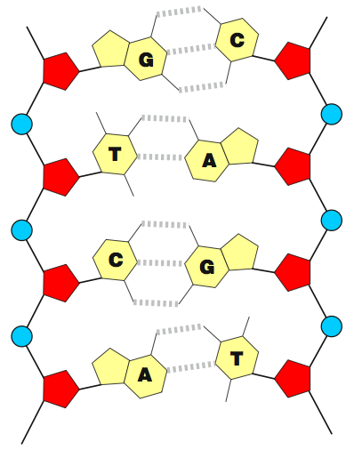
DNA & RNA Compared
Structural differences between DNA and RNA include:
 | DNA | RNA
Strands | Double | Single
Sugar | Deoxyribose | Ribose
Bases | Guanine | Guanine
 | Cytosine | Cytosine
 | Thymine | Uracil
 | Adenine | Adenine

Slide 26
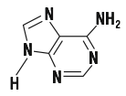

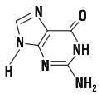

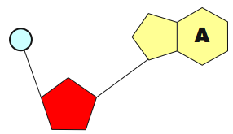






Nucleotide Bases
Purines
Adenine
The base component of nucleotides which comprise the genetic code.
• Double-ringed
structures
Guanine
• Always pair up with pyrimidines
Pyrimidines
Cytosine
• Single-ringed
structures
Base component of a nucleotide
Thymine
• Always pair up
with purines
Uracil

Slide 27
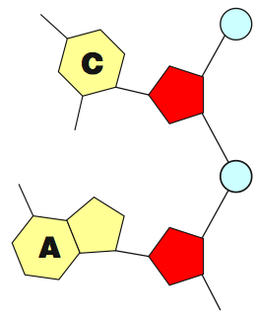

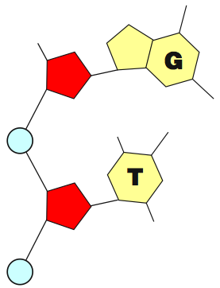
DNA Structure
Phosphates link neighboring nucleotides together to form one half of a double-stranded DNA molecule:
Purine base (guanine)
Pyrimidine base (cytosine)
Sugar (deoxyribose)
Phosphate
Hydrogen bonds
Purine base (adenine)
Pyrimidine base (thymine)

Slide 28
DNA Molecule
Purines join with pyrimidines in the DNA molecule by way of relatively weak hydrogen bonds with the bases forming cross-linkages.
This leads to the formation of a double-stranded molecule of two opposing chains of nucleotides:
  The symbolic diagram shows DNA as a flat structure.
  The space-filling model shows how, in reality, the DNA molecule twists into a spiral structure.
Symbolic representation
Space-filling model
Hydrogen bonds

Slide 29
The Genetic Code
DNA codes for assembly of amino acids.
The code is read in a sequence of three bases called:
  Triplets on DNA
  Codons on mRNA
  Anticodons on tRNA
Each triplet codes for one amino acid, but
more than one triplet may encode some amino
acids (the code is said to be degenerate).
There are a few triplet codes that make up
the START and STOP sequences for polypeptide
chain formation (denoted below in the mRNA form):
  START: AUG
  STOP: UAA, UAG, UGA

Slide 30
The Genetic Code
START: AUG
STOP: UAA, UAG, UGA
  EXAMPLE:
  A mRNA strand coding for six amino acids with a start and stop sequence:
AUG | ACG | GUA | UUA | CCC | GAA | GGC | UAA
START
STOP

Slide 31
Decoding the Genetic Code
Amino Acid | Codons | No.
Alanine | GCU GCC GCA GCG | 4
Arginine | CGU CGC CGA CGG AGA AGG | 6
Asparagine | AAU AAC | 2
Aspartic Acid | GAU GAC | 2
Cysteine | UGU UGC | 2
Glutamine | CAA CAG | 2
Glutamic Acid | GAA GAG | 2
Glycine | GGU GGC GGA GGG | 4
Histidine | CAU CAC | 2
Isoleucine | AUU AUC AUA | 3
Leucine | UAA UUG CUU CUC CUA CUG | 6
Lysine | AAA AAG | 2
Methionine | AUG | 1
Phenylalanine | UUU UUC | 2
Proline | CCU CCC CCA CCG | 4
Serine | UCU UCC UCA UCG AGU AGC | 6
Threonine | ACU ACC ACA ACG | 4
Tryptophan | UGG | 1
Tyrosine | UAU UAC | 2
Valine | GUU GUC GUA GUG | 4
Two-base codons would not give enough combinations with the 4-base alphabet to code for the 20 amino acids commonly found in proteins (it would provide for only 16 amino acids).
Many of the codons for a single amino acid differ only in the last base. This reduces the chance that point mutations will have any noticeable effect.

Slide 32


Genes and Proteins
Three nucleotide bases make up a triplet which codes for one amino acid.
Groups of nucleotides make up a gene which codes for one polypeptide chain.
Several genes may make up a transcription unit, which codes for a functional protein.
Functional
protein
Polypeptide chain
Triplet
Gene

Slide 33


Genes and Proteins
Functional
protein
This polypeptide chain forms one part of the functional protein.
This polypeptide chain forms the other part of the functional protein.
Polypeptide chain
Polypeptide chain
TAC on the template DNA strand
Amino acids
A triplet codes for one amino acid
Protein synthesis: transcription and translation
START
Triplet
Triplet
Triplet
Triplet
Triplet
Triplet
Triplet
STOP
START
Triplet
Triplet
Triplet
Triplet
Triplet
Triplet
STOP
3 '
5 '
DNA
Gene
Gene
Transcription unit
Three nucleotides make up a triplet
In models of nucleic acids, nucleotides are denoted by their base letter.
Nucleotide

Slide 34


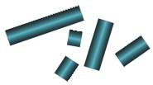

Introns and Exons
Most eukaryotic genes contain segments of protein-coding sequences (exons) interrupted by non-protein-coding sequences (introns).
  Introns in the DNA are long sequences of codons that have no protein-coding function.
  Introns may be remnants of now unused ancient genes.
  Introns might also facilitate recombination between exons of different genes; a process that may accelerate evolution.
DNA
Intron
Intron
Intron
Intron
Intron
Double stranded molecule of genomic DNA
Exon
Exon
Exon
Exon
Exon
Exon
Transcription
Both exons and introns are transcribed to produce a long primary RNA transcript
Primary RNA transcript
The primary RNA transcript is edited
Exons are spliced together
messenger RNA
Introns are removed
Translation
Messenger RNA is an edited copy of the DNA molecule (now excluding introns) that codes for a single functional RNA product, e.g. protein.
Protein
Introns

Slide 35
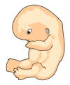







Cell Division
Male
adult
A single set of chromosomes
Male
embryo
Sperm
Many mitosis
divisions
Meiosis
2N
1N
A double set of chromosomes
2N
Fertilization
Several mitotic
divisions
Many mitotic
divisions
Somatic cell production
Gamete production
Zygote
2N
Embryo
Adult
2N
2N
Somatic cell production
Somatic cell production
Female
embryo
Female
adult
Many mitosis
divisions
Meiosis
Egg
2N
2N
1N

Slide 36
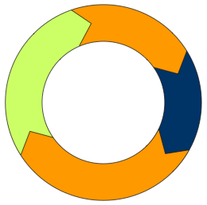
The Cell Cycle
The process of mitosis is only part of a continuous cell cycle where most of the cell's 'lifetime' is spent carrying out its prescribed role; a phase in the cycle called interphase.
Interphase is itself divided up into three stages:
  G1 First Gap
  S Synthesis
  G2 Second Gap
Mitosis is the process by
which the cell produces
two new daughter cells
from the original parent cell.
Second gap as cell grows and ensures DNA replication is complete
Synthesis of DNA to replicate chromosomes
G2
S
The
cell
cycle
M
Mitosis
G1
First gap as cell monitors its surroundings, growing and determining whether to replicate DNA

Slide 37
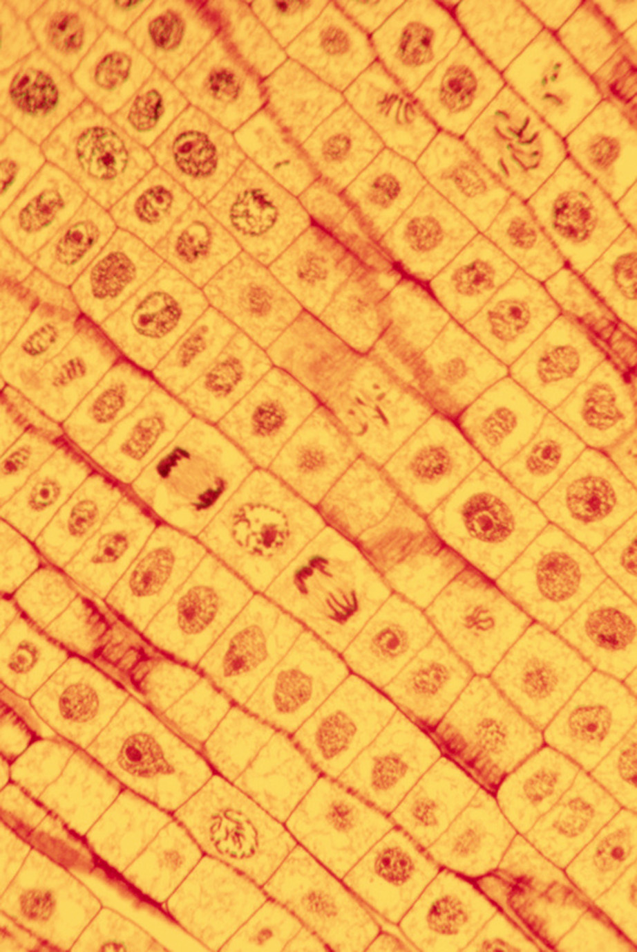
Mitosis in Onion Cells
If the cells of a growing root tip are examined, a proportion of them are in mitosis. Cells in different stages of division can be seen, but the majority of the cells are in interphase.
  This reflects the large proportion of the cell cycle spent in interphase.
Prophase
Anaphase
Late anaphase
Telophase

Slide 38









Mitosis
Centrosome, which later forms the spindle, is also replicated.
Interphase
Early Prophase
Late Prophase
Nuclear
Membrane
Cell enters mitosis
Nucleolus
Metaphase
DNA is replicated to form 2 chromatids
DNA continues condensing into chromosomes and the nuclear membrane begins to dissolve
Chromosomes continue to coil up and appear as double-chromatids
The mitotic spindle is formed to organize the chromosomes. The spindle consists of fibers made of microtubules and proteins.
Anaphase
Division of the cytoplasm (cytokinesis) is complete.
The two daughter cells are now separate cells in their own right.
Two new nuclei form. The cell plate forms across the midline of the parent cell. This is where the new cell wall will form.
The chromosomes segregate, pulling the chromatids apart
Cytokinesis
Telophase
Late Anaphase

Slide 39
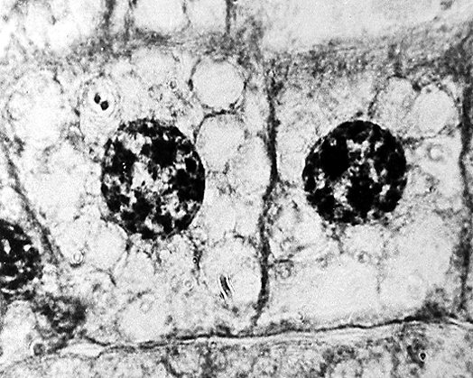
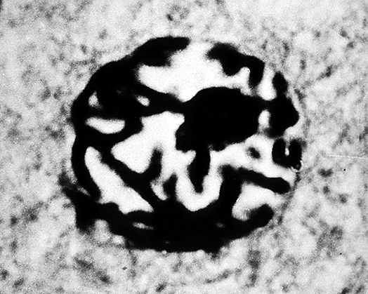
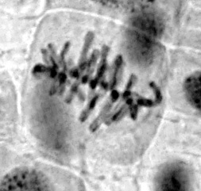



Mitosis Micrographs
Cell division for somatic growth and repair.
1. Interphase
2. Prophase
3. Metaphase
6. Telophase
5. Late Anaphase
4. Anaphase

Slide 40














Meiosis
2N
2N
Crossing over may occur at this stage in meiosis
The purpose of meiosis is to produce haploid sex cells.
Haploid sex cells have only one copy of each homologous pair of autosomes plus one sex chromosome.
First Division
(Reduction division)
2N
1N
Intermediate cell
Intermediate cell
Second Division
('Mitotic' division)
1N
Gametes
(eggs or sperm)
1N

Slide 41

Meiosis I
Interphase
DNA replication
2N
The first division of meiosis is called a ‘reduction’ division because it reduces (halves) the number of chromosomes.
One chromosome from each homologous pair is donated to each intermediate cell.
Prophase 1
Synapsis and crossing over
2N
Metaphase 1
Bivalents line up on the equator
2N
Anaphase 1
Telophase 1
1N
Intermediate cell
Intermediate cell

Slide 42

Meiosis II
NOTE: Half the full chromosome complement shown
1N
The second division of meiosis is called a ‘mitotic’ division, because it is similar to mitosis.
Sister chomatids of each chromosome are pulled apart and are donated to each gamete cell.
Intermediate cell
Prophase 2
1N
Metaphase 2
Anaphase 2
Telophase 2
1N
Gamete (egg or sperm)
Gamete (egg or sperm)

Slide 43









Meiosis & Mitosis Compared
MEIOSIS
MITOSIS
2N
2N
Homologous chromosomes pair up at the equatorial plate
Meiosis I
Reduction division
Cell division
Homologous chromosomes do not pair up at the equatorial plate
Meiosis II
‘Mitotic’ division
Cell division
Cell division
1N
2N

Slide 44





Non-disjunction in Meiosis I
The meiotic spindle normally distributes chromosomes to daughter cells without error.
Sometimes, homologous chromosomes or sister chromatids fail to separate.
  In these cases, one gamete receives two of the same type of gamete and the other gamete receives no copy.
This mishap, called non-disjunction,
results in abnormal numbers of chromosomes in the gametes.
This example shows non-disjunction in meiosis I; homologous chromosomes fail to separate properly at anaphase
during meiosis I.
Meiosis I
Meiosis II
n+1
n+1
n–1
n–1
Non-disjunction in Meiosis I

Slide 45





Non-disjunction in Meiosis II
Non-disjunction can also occur in meiosis II, when sister chromatids fail to separate during anaphase of meiosis II.
In cases of non-disjunction, if either of the aberrant gametes unites with a normal one at fertilization, the offspring will have an abnormal chromosome number
(e.g. 2N+1 or 2N–1).
  This is known as aneuploidy and it accounts for chromosomal defects such as Down syndrome (trisomy 21) and Edward syndrome (trisomy 18).
Meiosis I
Meiosis II
n+1
n–1
n
n
Non-disjunction in Meiosis II

Slide 46


DNA Replication 1
DNA is replicated to produce an exact copy of a chromosome in preparation for cell division.
The first step requires that the coiled DNA is allowed to uncoil by creating a swivel point.
Single-armed chromosome
as found in non-dividing cell
Temporary break to allow swivel
Replication fork

Slide 47



DNA Replication 2
New pieces of DNA are formed from free nucleotide units joined together by enzymes.
The free nucleotides (yellow) are matched up to complementary nucleotides in the original strand.
Free nucleotides
are used to construct
the new DNA strand
Parent strand of DNA is used as a template to match nucleotides for the new strand
The new strand of DNA is constructed using the parent strand as a template

Slide 48


DNA Replication 3
The two new strands of DNA coil up into a helix.
Each of the two newly formed DNA strands will go into forming a chromatid.
The double strands of DNA coil up into a helix
Each of the two newly formed DNA double helix molecules will become a chromatid

Slide 49



DNA Replication 4
Free nucleotides with their corresponding bases are matched up against the template strand following the base pairing rule:
A | pairs with | T
T | pairs with | A
G | pairs with | C
C | pairs with | G
Template strand
Template strand
Two new strands forming

Slide 50

Control of DNA Replication
5'
3'
DNA replication is controlled by enzymes at key stages:
Double strand of original (parental) DNA
Overall direction
of replication
Swivel point
Leading strand
Helicase
RNA polymerase
DNA polymerase III
DNA polymerase III
Replication
fork
Direction of synthesis
DNA polymerase I
Direction of synthesis
DNA ligase
3'
5'
5'
3'

Slide 51

The Leading Strand
Enzymes can build strands
only in the 5’ to 3’ direction
This means that only one strand, called the leading strand, can be synthesized as a continuous strand.
5'
3'
Overall direction
of replication
1
Helicase: Splits and unwinds the two-stranded DNA molecule.
Swivel point
DNA polymerase III
The parental strand provides a 'template' for synthesis of the new strand
Replication
fork
2
The leading strand is synthesized continuously in the 5' to 3' direction by DNA polymerase III.
3'
Direction of synthesis
5'
5'

Slide 52

The Lagging Strand
The other complementary strand, called the lagging strand, must be constructed in fragments, which are later joined together.
5'
3'
2
RNA polymerase:
Makes a short RNA primer which is later removed.
Overall direction
of replication
3
DNA polymerase III:
Extends RNA primer with short
lengths of complementary DNA to make Okazaki fragments.
Swivel point
1
Helicase: Splits and unwinds the two-stranded DNA molecule.
RNA primer
Direction of synthesis
New complementary strand is synthesized discontinuously, in fragments 1000-2000 bp long
3'
5'

Slide 53

Enzyme Control of Replication 4
5'
3'
Overall direction
of replication
4
DNA polymerase I: Digests the RNA primer and replaces it with DNA
5
DNA ligase: Joins neighboring fragments together into longer strands.
The lagging strand is formed in fragments (called Okazaki fragments) which are later joined together.
Direction of
synthesis
3'
5'
3'

Slide 54


Genome of a Virus
The complete genome (base sequence) of the øX174 bacterial virus:
  This genome comprises
  nine genes, each coding
  for a different protein.
  The highlighted section is
  a single gene. Some genes overlap.
  The human genome is
  about 1 million times larger than this.
Start
φX174 bacterial virus

Slide 55




Genes to Proteins
The central dogma of molecular biology for the past 50 years has stated that genetic information, encoded in DNA, is transcribed into molecules of RNA, which are then translated into the amino acid sequences that make up proteins. This simple view is still useful.
  The nature of a protein determines its role in the cell.
  Reverse transcription is carried out by some RNA viruses.
  It converts viral RNA into DNA, which
  is incorporated into the host’s genome.
Amino acid
Structural?
tRNA
Regulatory?
Reverse transcription
Contractile?
Immunological?
Transcription
Translation
Transport?
Protein
DNA
mRNA
Catalytic?

Slide 56



Prokaryotic Gene Expression
The process of transferring the information encoded in a gene to its functional gene product is called gene expression.
  The simple “one-gene protein” model is supported by studies of prokaryotic genomes, where much of the DNA comprises protein-coding genes.
Gene for a protein
DNA
Transcription
RNA transcript
Translation
Gene regulation
The DNA of prokaryotes consists almost entirely of protein-coding genes and their regulatory sequences
Protein
Structural and regulatory functions

Slide 57






Eukaryotic Gene Expression
DNA gene containing both intronic and exonic DNA
Transcription
Primary RNA transcript
Gene regulation
Gene regulation
Splicing
Intronic RNA
Assembled exonic RNA
processing
processing
mRNA
Translation
microRNAs
Non-coding RNA
Roles in genomic regulation
Role in the timing of development
Diverse functions

Slide 58
The Primary RNA Transcript
In contrast to prokaryotes, eukaryotic genomes contain a large amount of DNA that does not code for proteins.
  This DNA, called intronic DNA or introns, is removed from the primary RNA transcript before the assembled exonic (protein-coding) DNA is translated.
DNA gene containing both intronic and exonic DNA
Primary RNA transcript
Transcription
Splicing
Assembled exonic RNA
Intronic RNA

Slide 59
Fate of Exonic RNA
Protein-coding exonic RNA is translated into proteins.
Thousands of RNAs are never translated into proteins. These may have a role in regulating the genome itself.
Assembled exonic RNA
Non-protein-coding RNA can be further processed
mRNA
Translation
Proteins carry out structural, transport, catalytic, and regulatory roles.
These non-protein coding RNAs may have regulatory roles in the cell

Slide 60

Fate of Intronic RNA
After being spliced from the primary RNA transcript, some of the intronic RNA is degraded and recycled, but a proportion undergoes further processing into microRNAs.
Hundreds of microRNAs, derived from introns and larger, non-protein-coding RNA transcripts, have already been identified. Many of them control timing of developmental processes.
The sequences coding for microRNAs are highly conserved (show little evolutionary change). This is an indication of their importance in gene regulation.
Processing of non-protein-coding RNA
MicroRNAs
Processing of intronic RNA

Slide 61







DNA in Eukaryotic Genomes
In constrast to prokaryotes, eukaryotic genomes contain a large amount of DNA that does not code for proteins.
100
An increase in complexity is associated with an increase in the proportion of non-protein-coding DNA.
80
60
Percentage of DNA not coding for proteins
40
20
0
Prokaryotes
One-celled eukaryotes
Fungi/plants
Invertebrates
Vertebrates
Humans

Slide 62
A Revision of Ideas
Genome sequence evidence suggests that non-protein-coding DNA encodes a vast number of RNA molecules with regulatory functions.
  In this new view of eukaryotic gene expression, an increase in complexity is associated with an increase in the proportion of non-protein-coding DNA.
  This makes sense if the intronic DNA has a role in regulating genome function.
Gene Expression in Eukaryotes
The Old View | The New View
Introns are spliced out of a primary RNA transcript | Introns are spliced out of a primary RNA transcript
All of the exon RNA (mRNA) is translated into proteins | Not all of the exon RNA is translated into proteins. Non-protein-coding RNA contributes to microRNAs or has a function on its own.
Introns are “junk DNA” with no assigned function. They are degraded and recycled. | Many introns are processed into microRNAs which appear to be involved in regulating development.

Slide 63





Transcription
DNA
A mRNA strand is formed using the DNA molecule as the template.
Free nucleotides with bases complementary to the DNA are joined together by the enzyme RNA polymerase.
Free nucleotides
used to construct
the mRNA strand
Single-armed
chromosome as found in non-dividing cell
RNA polymerase enzyme
Template strand of DNA contains the information for the construction of a functional mRNA product (e.g. a protein)
Direction of synthesis
Coding strand
The two strands of DNA coil up into a double helix
Formation of a single strand of mRNA that is complementary to the template strand (therefore the same “message” as the coding strand)

Slide 64




Movement of mRNA
In eukaryotic cells, the two main steps in protein synthesis occur in separate compartments: transcription in the nucleus and translation in the cytoplasm.
  mRNA moves out of
  the nucleus, to the
  cytoplasm, through pores in
  the nuclear membrane.
In prokaryotic cells, there is no nucleus, and the chromosome is in direct contact with the cytoplasm, and protein synthesis can begin even while the DNA is being transcribed.
Ribosomes
mRNA
Nuclear pore through
which the mRNA passes
into the cytoplasm
Nucleus
Cytoplasm

Slide 65
mRNA Codes for Amino Acids
Read second letter here
Second Letter
Read third letter here
Read first letter here
 | U |  | C |  | A |  | G
U | UUU | Phe | UCU | Ser | UAU | Tyr | UGU | Cys | U
 | UUC | Phe | UCC | Ser | UAC | Tyr | UGC | Cys | C
 | UUA | Leu | UCA | Ser | UAA | STOP | UGA | STOP | A
 | UUG | Leu | UCG | Ser | UAG | STOP | UGG | Try | G
C | CUU | Leu | CCU | Pro | CAU | His | CGU | Arg | U
 | CUC | Leu | CCC | Pro | CAC | His | CGC | Arg | C
 | CUA | Leu | CCA | Pro | CAA | Gln | CGA | Arg | A
 | CUG | Leu | CCG | Pro | CAG | Gln | CGG | Arg | G
A | AUU | Iso | ACU | Thr | AAU | Asn | AGU | Ser | U
 | AUC | Iso | ACC | Thr | AAC | Asn | AGC | Ser | C
 | AUA | Iso | ACA | Thr | AAA | Lys | AGA | Arg | A
 | AUG | Met | ACG | Thr | AAG | Lys | AGG | Arg | G
G | GUU | Val | GCU | Ala | GAU | Asp | GGU | Gly | U
 | GUC | Val | GCC | Ala | GAC | Asp | GGC | Gly | C
 | GUA | Val | GCA | Ala | GAA | Glu | GGA | Gly | A
 | GUG | Val | GCG | Ala | GAG | Glu | GGG | Gly | G
First Letter
Third Letter

Slide 66




Translation
Translation is the process of building a polypeptide chain from amino acids, guided by the sequence of codons on the mRNA.
Structures involved in translation:
  Messenger RNA molecules (mRNA) carries
  the code from the DNA that will be translated
  into an amino acid sequence.
  Transfer RNA molecules (tRNA) transport amino acids to their correct position on the mRNA strand.
  Ribosomes provide the environment for
  tRNA attachment and amino acid linkage.
  Amino acids from which the polypeptides
  are constructed.
The speckled appearance of the rough endoplasmic reticulum is the result of ribosomes bound to the membrane surface.
mRNA
Ribosomes
tRNA
Amino acids

Slide 67

Ribosomes & tRNA
Ribosome
  Comprises two subunits in which there are grooves where the mRNA strand and polypeptide chain fit in.
  The ribosomal subunits are constructed of protein and ribosomal RNA (rRNA).
  The subunits form a functional unit only when they attach to a mRNA molecule.
tRNA molecule
  There is a specific tRNA molecule and anticodon for each type of codon.
  The anticodon is the site of the 3-base sequence that 'recognizes' and matches up with the codon on the mRNA molecule.
Ribosome
Large subunit
Small subunit
Amino acid attachment site
Ribosome attachment point
The 3-base sequence of the anticodon is complementary to the codon on the mRNA molecule
Anticodon
Transfer RNA molecule

Slide 68




Translation: Initiation
The first initiation stage of translation brings together mRNA, a tRNA bearing the first amino acid of a polypeptide, and the two ribosomal subunits.
  The small ribosomal sub-unit attaches to a specific nucleotide sequence on the mRNA strand just ‘upstream’ the initiation codon (AUG) where translation will start. The initiator tRNA, carrying methionine, attaches to the initiator codon.
  The large ribosomal sub-unit binds to complete the protein-synthesizing complex.
Initiator tRNA
Activated
Thr-tRNA
Small ribosomal unit attaches
Large ribosomal unit attaches to form a functional ribosomal protein-synthesizing complex
mRNA
P
site
A
site
Ribosomes move in this direction
Ribosome

Slide 69







Translation: Elongation
In the elongation stage of translation, amino acids are added one by one by tRNAs as the ribosome moves along the mRNA. There are three steps:
  The correct tRNA binds to the A site on the ribosome.
  A peptide bond forms between adjacent amino acids.
  The tRNA at the P site is released. The tRNA at the A site, now attached
  to the growing polypeptide, moves to the P site and the ribosome advances
  by one codon. This step requires energy.
Activated
Tyr-tRNA
Growing polypeptide
Unloaded
Thr-tRNA
mRNA
5’
P site
A site

Slide 70




Translation: Termination
The final stage of protein synthesis (termination) occurs when the ribosome reaches a stop codon.
  A release factor binds to the stop
  codon and hydrolyzes the completed
  polypeptide from the tRNA, releasing
  the polypeptide from the ribosome.
Release factor
Completed polypeptide
Completed polypeptide is released
  The ribosomal units then fall
  apart so that they can be recycled.

Slide 71


Overview of Translation
Activating
Lys-tRNA
Polypeptide chain in an advanced stage of synthesis
Activated
Tyr-tRNA
Growing polypeptide
Unloaded
Thr-tRNA
Start codon
Ribosome
mRNA
Ribosomes moving in this direction

Slide 72














Structures Involved With Protein Synthesis
c mRNA molecule
Nuclear membrane
Free
amino acids
DNA molecule
Free nucleotides
Unloaded tRNA
RNA polymerase
Polypeptide chain
Ribosome
mRNA molecule
Nuclear pores
Cytoplasm
Nucleus
Label structures A-J

Slide 73
c mRNA molecule
Processes Involved With Protein Synthesis
Adding nucleotides to create mRNA
tRNA recharged with amino acid
Unloaded tRNA leaves translation complex
Unwinding DNA molecule
RNA polymerase
tRNA with amino acid is drawn into the ribosome
DNA molecule rewinds
mRNA moves to cytoplasm
tRNA adds amino acid to growing polypeptide
Nucleus
Cytoplasm

Slide 74

Translation in Prokaryotes
In prokaryotes (i.e. bacteria) there is no nucleus and translation may proceed while mRNA is still being transcribed.
As in eukaryotes, there may be strings of ribosomes bound to a single mRNA molecule.
  These polyribosomes enable the rapid production of multiple copies of a polypeptide.
DNA
RNA polymerase
tRNA
mRNA
Ribosome

Slide 75

Analyzing DNA on a Gel
Gel electrophoresis separates macromolecules, such as proteins or DNA, on the basis of their rate of movement through a gel under the influence of an electric field.
  Nucleotides have a negative charge and will move towards the positive electrode in an electric field.
  Radio-labeled DNA fragments of different sizes will migrate in the gel at a rate determined by their size and charge.
  The gel impedes longer fragments more than shorter ones, so shorter fragments travel the greatest distance.
-ve
Negative terminal
C
T
A
G
DNA samples
Four identical samples of DNA fragments of different sizes are placed in wells at the top of the column of gel.
Acrylamide or agarose gel
Power
pack
Radio-labeled DNA fragments
attracted to the positive terminal
The smaller fragments of DNA move down the column quickly. Larger fragments move more slowly and do not travel as far through the gel.
+ve
Positive terminal

Slide 76

Reading a DNA Sequence
G
A
T
C
T
Larger radio-labeled DNA fragments travel more slowly
T
A
A
G
C
T
C
G
A
G
C
C
A
Acrylamide or agarose gel through which the DNA fragments are moving
T
G
G
G
The DNA sequence is read in this direction
C
C
C
Radio-labeled
DNA fragments move downward through the gel
C
T
A
G
G
A
G
A
T
C
T
C

Slide 77

Interpreting a DNA Sequence
Triplet
Triplet
Triplet
Triplet
Triplet
Triplet
Triplet
Triplet
Triplet
Triplet
Triplet
C | G | T | A | A | G | T | A | C | T | T | G | A | T | C
A | G | A | G | C | T | C | T | T | C | G | A | A | A | A | T | C | G
(DNA sequence read from the gel, comprising the radioactive nucleotides that bind to the coding strand DNA in the sample)
Synthesized DNA
Replication
G | C | A | T | T | C | A | T | G | A | A | C | T | A | G
T | C | T | C | G | A | G | A | A | G | C | T | T | T | T | A | G | C
(This is the DNA that is being investigated)
DNA Sample
Transcription
 | A | G | A | G | C | U | C | U | U | C | G | A | A | A | A |  | U | C | G
 |  |  |  |  |  |  |  |  |  |  |  |  |  |  |  | mRNA
Read in this direction
C | G | U | A | A | G | U | A | C | U | U | G | A | U | C
 |  |  |  | Translation
ARG |  |  | LYS |  | TYR | LEU |  | ISO | ARG | ALA | LEU |  | ARG | LYS |  | SER
 |  |  |  |  |  |  |  |  |  |  |  |  |  |  | Amino acids
 |  |  |  |  |  |  | Part of a polypeptide chain
A
T
G
C
T
C
G
A

Slide 78
The Genetic Code: Overview
The information for the control and development of an organism is contained in the nucleus of the organism’s cells.
The nucleus contains DNA, which carries this information in the form of genes.
Genes code for polypeptides and other functional RNA products.
Polypeptides make up proteins, which have a range of structural and regulatory functions.
Enzymes and RNA molecules are involved in gene regulation and the control of metabolism.

Slide 79
The Genetic Code: Overview
Mitosis
  Cells undergo mitotic division during which time the genetic material is doubled and divided into two cells.
Meiosis
  Meiosis is a reduction division that results in the formation of haploid (N) cells from diploid (2N) ones.
  Its purpose is to produce gametes
  for sexual reproduction.
  During meiosis, genetic material is exchanged between chromosomes;
  this introduces genetic variation into
  the offspring.

Slide 80


Slide 81
Terms of Use
Biozone International retains copyright to the intellectual property included in this presentation file, with acknowledgement that certain photos are used under license and are credited appropriately on the next screen.
You MAY:
  Use these slides for presentations in your classrooms using a data projector, interactive whiteboard, and overhead projector.
  Place these files on the school’s intranet (school computer network), but not in contradiction of clause 3 (a) below.
  Edit and customize this file by adding, deleting, and modifying information to better suit your needs.
  Place these presentation files on any computer within the school, including staff laptops.
  Print out this file in PowerPoint “Handouts” format as per the print dialogue box, for the express purpose of allowing students to make their own notes about the presentation.
You MAY NOT:
  Put these presentation files onto the internet or on a service that may be accessed offsite from the campus, unless access to the service is protected by a user login and password protocol.
  Print these files onto paper to make your own worksheets for distribution to students.
  Create a NEW document using any of the graphics/images in this presentation file.
  Incorporate any part of this presentation file for the production of another commercial product.
  REMOVE any of the references to Biozone, the copyright notices, photo credits, or terms of use from this file.

Slide 82
Photo Credits
Photographic images are used under licence from the following photo libraries:
  Corel Corporation Professional Photos
  (various titles, including: Science & Medicine, Agriculture).
  ArtToday.com
  Clipart.com
  PhotoDisc Inc.
  Hemera Technologies Inc.
  PhotoObjects.com
  CDC Public Health Image Library (PHIL)
Additional artwork and photographs are the property of Biozone International Ltd.
BIOZONE International Ltd | P.O. Box 13-034, 109 Cambridge Road, Hamilton, NEW ZEALAND
Phone: + 64 7 856-8104 | Fax: + 64 7 856-9243 | E-mail: sales@biozone.co.nz | Internet: www.biozone.co.nz
Copyright © 2005 Biozone International Ltd
All rights reserved

Slide 83







Presentation MEDIA
See our other titles:
See full details on our web site:
www.thebiozone.com/media.html

